Slide 1

Solar Management System

Slide 2

Contents
Introduction
Background
Problem and Motivation
Aim and Objectives
System overview
Literature review
Methodology
System Functions
Tools and Technology
Gannet Chart

Slide 3

Introduction

Slide 4



Background
Btechsolar & solutions is a company which sells and repairs solar equipment.
Company maintains its records manually.
Impossible to record details manually in a practical environment.
Company provides reliable and quality customer services
- 071-XXXXXXX
- Btechsolar@gmail.com
- Kottawa,Sri Lanka

Slide 5

Problem and Motivation

Slide 6

Problem and Motivation
Customer should reach manually - Online appointment platform for Customers
Manual Record keeping - Online Database for Realtime Updating and Backups
Physical Payments - Online Payment Methods
Poor Storages and record storing facilities - Standard warehouses and cloud computing
Fast tech growth - Easy to use application with user guidelines

Slide 7

Aim and Objectives

Slide 8

Aim

Slide 9
Objectives
To manage customer details properly
To increase efficiency of employee management
To increase productivity of usage of supply inventories
To increase reliability of finance
To manage the project activities
To supply quality repair and service
To manage transport and delivery service productivity
To ensure that customers are aware of the existence and positioning of products

Slide 10

System Overview

Slide 11
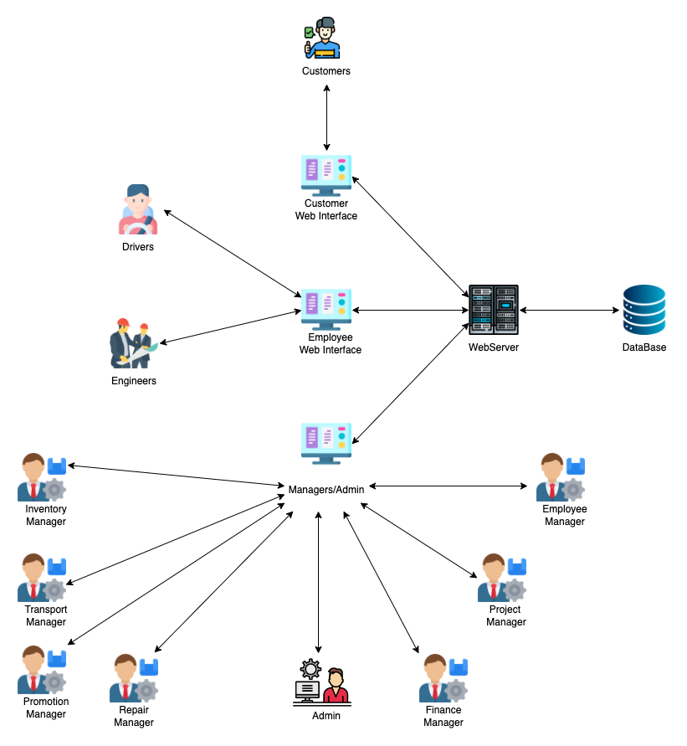

Slide 12

System Functions

Slide 13
Employee Management System
1.Login
2.Add new employees
3.View employee details
4.Update employee details
5.Delete employee details
6.Generate monthly attendance report

Slide 14
Repair Management
1. Login.
2. Add new repair requests.
3. View repair request.
4. Update repair request.
5. Delete repair request.
6. Calculating the estimated cost of repair.
7. Generate monthly repair balance report

Slide 15
Inventory Management System
1. Login.
2. Add New Items to the Inventory.
3. View Inventory.
4. Update Inventory.
5. Delete Items in the Inventory.
6. Generate monthly reports on the balance of inventory and What Items need to be purchase

Slide 16
Customer Management System
1. Login.
2. Customer registration.
3. View customer details.
4. Update customer details.
5. Delete customer details.
6. Generate weekly customer reports

Slide 17
Finance Management System
1. Login.
2. Manage payment method.
3. Manage expenses.
4. View the bill report.
5. Calculate the salary of the employees.
6. Calculating monthly income.
7. Generate weekly and monthly income reports

Slide 18
Project Management System
1. Login
2. Add new projects
3. View projects
4. Update projects
5. Delete projects
6. Generate a report of projects

Slide 19
Transport Management System
1. Login.
2. Add new vehicle details .
3. View transport details.
4. Update vehicle details.
5. Delete transport details.
6. assign drivers.
7. Generate monthly transport report

Slide 20
Promotion and Offers Management
1. Login.
2. Add new promotions and offers details.
3. View promotions and offers details.
4. Update promotions and offers details.
5. Delete promotions and offers details.
6. Generate monthly sales reports with promotions and offers.

Slide 21

Tools And Technology

Slide 22

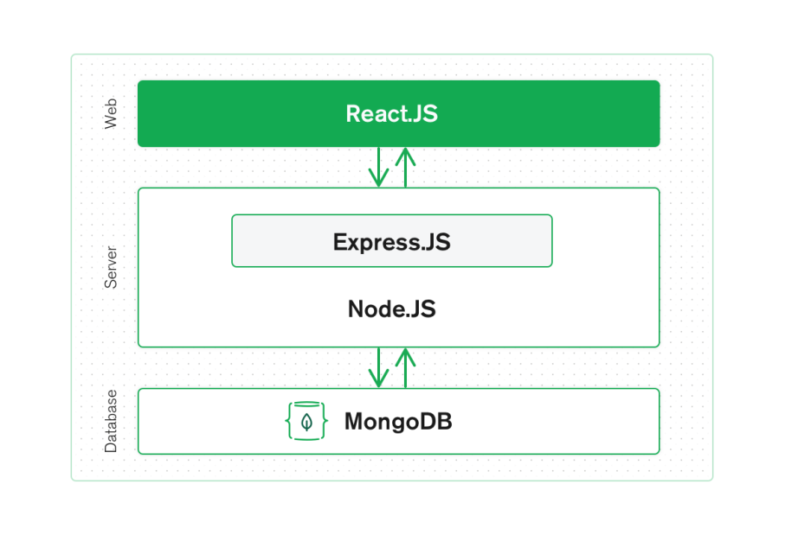
Technology

Slide 23






Tools
Visual Studio
Figma
Microsoft SharePoint
Microsoft Teams
Github
Postman

Slide 24
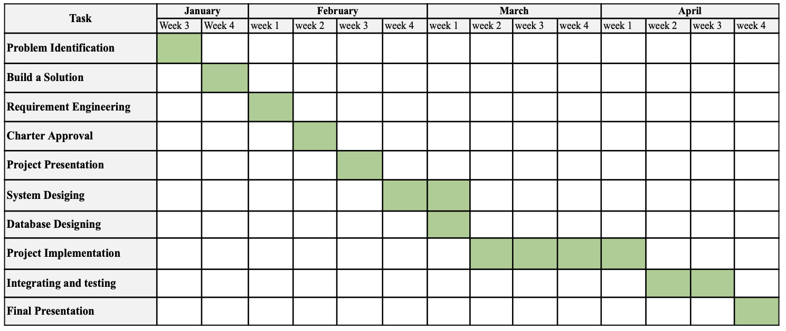
Gantt Chart

Slide 25
Solar Management System
Our Team

Slide 26
Thank You

